Slide 1
Plagiarism and how to avoid it
ISTP LECTURE

Slide 2
Why do we have written assignments
For your skills as a thinker and a writer to develop
Research papers are meant to build your skills in analysis and original thinking
Projects like ISTP which have a research component helps you develop all these skills.
Most importantly it helps you present and communicate your research to others
It also helps your instructor to evaluate you
In other words, the report writing part of ISTP builds your essential skills
As with any assignment the main goal is not the paper or the grade but rather your opportunity to develop your thinking and build your skill sets

Slide 3
What is plagiarism
Stealing some one else’s ideas and words and passing it on as your own

Slide 4
Why is plagiarism wrong?
Plagiarism defeats the purpose of writing assignments. When you plagiarise you are using some one else’s ideas and words. These actions do not help you build any skills (other than that of copy-pasting). Thus in committing plagiarism the person you are really cheating is yourself
Plagiarism is like lying. When you pass someone else’s work as your own you are engaging in unethical behavior. This can also destroy the mutual respect which exists between a professor and a student.
The basis of academia is trust. When we read an academic piece we trust that the author has represented facts to the best of his ability. Plagiarism undercuts this very foundation of trust.
Plagiarism defeats the purpose of scholarship, i.e. your ability to learn and grow
Source: University of Oklahoma, Academic Integrity website

Slide 5
Types of plagiarism
One of the most common types of publication misconduct is plagiarism–when one author deliberately uses another's work without permission, credit, or acknowledgment. Plagiarism takes different forms, from literal copying to paraphrasing some else's work and can include:
Data
Words and Phrases
Ideas and Concepts
Source: ethics.elsevier.com

Slide 6
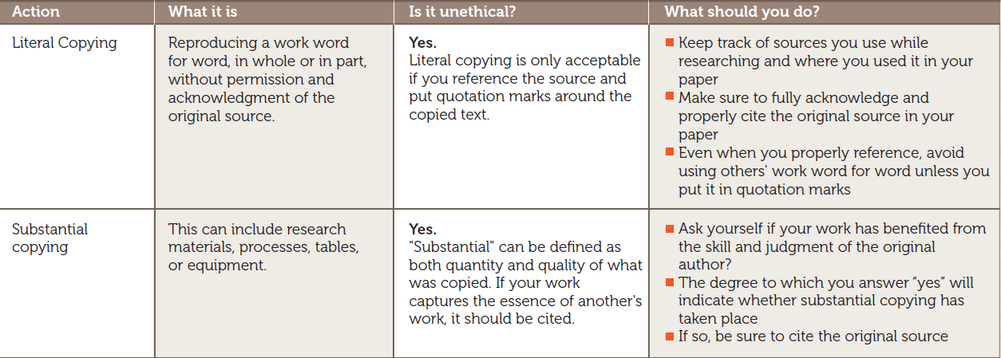
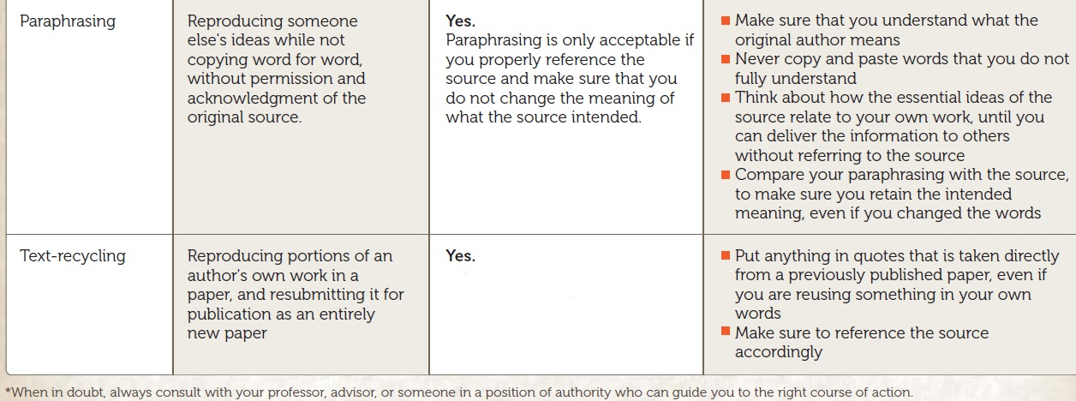
plagiarism
Source: ethics.elsevier.com

Slide 7
How to prevent plagiarism
Take good notes. Whenever you are reading a book or article for an assignment keep notes of the citation information and put in quotation mark any direct quotes
Take time to think. When you are writing your report, think about the topic and your findings, results and analysis. When you understand what you are doing you will be able to express yourself in your own words.
Begin writing. Remember writing is an art. You need to be able to write multiple drafts. With each iteration your work will get better. Remember that grammatical error and spelling mistakes are easy to fix. As instructors we don’t mind if your English is a little weak, but plagiarism under any circumstances is unacceptable
Follow proper citation methods.

Slide 8
citation
Crediting the work of others (including your advisor’s or your own previous work) by citation is important for at least three reasons:
it places your own work in context, and
it acknowledges the findings of others on which you have built your research
it maintains the credibility and accuracy of the scientific literature
Examples:
Previously we (Attwood and Florence, 2002) reported that the…
The work of Illum and Davis (1988) drew attention to ….
According to Ilum and Davis (1988)….
“Plagiarism” Presented by: Alexander T Florence, Elsevier

Slide 9
DATA
Data, statistics, illustrations also need to be cited. If something is common knowledge it need not be cited. But any time specific data is used which is not part of common knowledge it needs to be cited.

Slide 10
quote
Deep in the tropical forest of Guatemala lie the remains of one of the great centers of Pre-Columbian civilization and one of the foremost archaeological sites in all the world. Its modern name is Tikal, but when it was the capital of one of the most powerful of all Maya kingdoms, it was known as Mutul.
Robert Sharer, The Ancient Maya (2006)

Slide 11
Right or Wrong?
Guatemala is home to one of the most important Mayan ruins. Its modern name is Tikal, but when it was the capital of one of the most powerful of all Maya kingdoms, it was known as Mutul.
WRONG!

Slide 12
Should have been in quotes!
Guatemala is home to one of the most important Mayan ruins. “Its modern name is Tikal, but when it was the capital of one of the most powerful of all Maya kingdoms, it was known as Mutul.”

Slide 13
Should have credited source!
Guatemala is home to one of the most important Mayan ruins. According to Robert Sharer, “Its modern name is Tikal, but when it was the capital of one of the most powerful of all Maya kingdoms, it was known as Mutul.”

Slide 14
Right or Wrong?
Guatemala is home to one of the most important Mayan ruins. The modern name of this ruin is Tikal, but it was known as Mutul during the time it was the capital of one of the most powerful of all Maya kingdoms.
WRONG!
Paraphrases must also be cited!

Slide 15
Right or Wrong?
Guatemala is home to one of the most important Mayan ruins. Its modern name is Tikal, but, according to Sharer, when it was the capital of one of the most powerful of all Maya kingdoms, it was known as Mutul.
RIGHT!

Slide 16
Plagiarism-sources not cited
The author submits an assignment copied word for word from a source different from his or her own
The author uses some of his or her own words in his or her submission, but substantial parts are taken without modification from a single source
The author tries to pass off a work as his or her own that has been stitched together from various sources with a few words being altered here and there to try to disguise the original phrasing.
The author tries to cover his or her lifting of the essential content of a source by minimally altering key words and phrases.
The author meticulously changes all phrases and words from one source into his or her own but neglects to cite the source.
Source: slideshare.net url: http://www.slideshare.net/aewinger/plagiarism-types?qid=0b5e4ab0-2a5e-4dab-a163-43b7b0bf7429&v=default&b=&from_search=1

Slide 17
Sources cited (but still plagiarized)
the author notes a source but does not include a specific in-text citation that leads to a reference citation that denotes the exact bibliographic information from the text. Therefore, the link between the in-text citation reference and reference page reference is broken.
The author scrambles information so that inaccurate information regarding the sources is noted. This makes the source impossible to find and accuracy cannot be determined.
The writer inserts a direct quote but tries to pass it off as a paraphrase because he or she did not put the direct quote in quotation marks but DID supply an in-text citation.
the writer accurately cites all paraphrases and gives credit where it is due, but the author neglected the requirement of submitting original work. Remember that all paraphrases should be based on excerpts from expert sources, not the entire source. Paraphrases, after being accurately cited, should also be accompanied by the writer’s personal analysis of the paraphrase.
In this situation of plagiarism, large sections of the author’s work are original but interspersed within the original are sections of un-cited paraphrases. In this way, the paraphrased material is passed off as the writer’s own.
Source: slideshare.net url: http://www.slideshare.net/aewinger/plagiarism-types?qid=0b5e4ab0-2a5e-4dab-a163-43b7b0bf7429&v=default&b=&from_search=1

